Slide 1

Project Report: Design Thinking Innovation Process
This comprehensive project report documents our journey through the complete Design Thinking process, from initial user research to final implementation. Design Thinking provides a human-centered framework for solving complex problems through empathy, creativity, and iterative testing. Our approach transformed user insights into actionable solutions that deliver measurable impact.

Slide 2
Executive Summary: Problem Statement and Solution Overview
The Challenge
Our Solution
Users struggled with fragmented workflows and disconnected tools that reduced productivity by 35%. Pain points included manual data entry, lack of integration between systems, and difficulty tracking progress across multiple projects. The market demanded a unified solution that would streamline operations while remaining intuitive and accessible.
We developed an integrated platform that consolidates essential workflows into a single, user-friendly interface. By leveraging automation and intelligent design, our solution reduces task completion time by 60% while improving accuracy and user satisfaction. The platform adapts to individual work styles and scales seamlessly with organizational growth.
35%
60%
92%
8
Productivity Loss
Time Saved
User Satisfaction
Weeks to Launch
Before intervention
With new solution
Post-implementation
From concept to rollout

Slide 3

Empathise Phase: Understanding User Needs and Pain Points
The Empathise phase formed the foundation of our Design Thinking process, immersing our team in the lived experiences of end users. We conducted extensive research to uncover genuine needs, frustrations, and aspirations that would inform our solution design.
User Interviews
Contextual Inquiry
Survey Analysis
Conducted 45 in-depth interviews with diverse user segments to understand daily workflows, challenges, and goals. Sessions revealed critical pain points around system integration and time management.
Observed users in their natural work environments for 120+ hours, documenting behaviors, workarounds, and frustration points that users themselves couldn't articulate in interviews.
Distributed surveys to 850 potential users, gathering quantitative data on feature priorities, usage patterns, and willingness to adopt new solutions. Response rate exceeded 68%.
"Understanding what users truly need—not just what they say they want—became our guiding principle. Empathy revealed hidden opportunities that transformed our approach."
Key Discoveries
Users spent 40% of their time on manual data transfer between systems
Lack of real-time visibility created anxiety and reduced team coordination
Existing tools were feature-rich but overwhelming and unintuitive
Mobile accessibility was critical for 67% of users who worked remotely
Training time exceeded 3 weeks for current platforms, causing adoption resistance

Slide 4

Define Phase: Synthesizing Insights and Defining the Challenge
In the Define phase, we transformed raw research data into actionable insights and a clear problem statement. This critical synthesis ensured our team aligned on what problem we were solving and for whom, establishing criteria for success.
01
02
Data Synthesis
Persona Development
Analyzed interview transcripts, observation notes, and survey results to identify patterns and recurring themes across user segments.
Created four detailed user personas representing primary user types, including their goals, behaviors, pain points, and technology comfort levels.
03
04
Journey Mapping
Problem Framing
Mapped current-state user journeys showing all touchpoints, emotions, and friction areas throughout typical workflows and task completion.
Crafted a concise problem statement that captured core user needs while remaining broad enough to encourage creative solution exploration.
Our Problem Statement
How might we create an integrated workflow solution that reduces manual effort while remaining intuitive enough for rapid adoption across diverse user skill levels?
This statement guided all subsequent ideation and design decisions, keeping our team focused on both efficiency gains and user experience excellence.
Success Criteria Established
Quantitative Metrics
Qualitative Goals
Reduce task completion time by 50%+
Users feel confident and in control
Achieve 80%+ user adoption within 3 months
Interface feels intuitive from first use
Decrease training time to under 1 week
Solution adapts to individual preferences
Improve data accuracy to 99%+
Support requests decrease significantly

Slide 5




Ideate Phase: Brainstorming Solutions and Creative Exploration
The Ideate phase unleashed our team's creative potential through structured brainstorming sessions designed to generate quantity over quality initially, then refine the most promising concepts. We encouraged wild ideas and deferred judgment to explore the full solution space.
Divergent Thinking
Convergent Analysis
Generated 200+ ideas without constraints, encouraging unconventional approaches and building on each other's suggestions.
Evaluated ideas against feasibility, desirability, and viability criteria to identify the most promising directions.
Selection & Synthesis
Concept Development
Team and stakeholders voted on concepts, combining complementary ideas into three comprehensive solution directions.
Refined top 15 ideas into detailed concept sketches with clear value propositions and implementation considerations.
Ideation Techniques Employed
Brainstorming Sessions
SCAMPER Method
Competitive Analysis
Five facilitated workshops with cross-functional teams including designers, developers, product managers, and customer success representatives to ensure diverse perspectives.
Applied Substitute, Combine, Adapt, Modify, Put to other uses, Eliminate, and Reverse prompts to existing solutions, generating innovative variations and improvements.
Examined 12 competitor solutions to identify gaps, opportunities, and best practices that could inspire differentiated features and superior user experiences.
Top Solution Themes
Our ideation process revealed that users valued simplicity and intelligence over feature abundance. The winning concepts emphasized automation that works invisibly, reducing cognitive load while maintaining user control. Integration and mobile accessibility emerged as non-negotiable requirements.
AI-powered automation
Unified dashboard interface
Contextual guidance system
Mobile-first design
Intelligent notifications

Slide 6
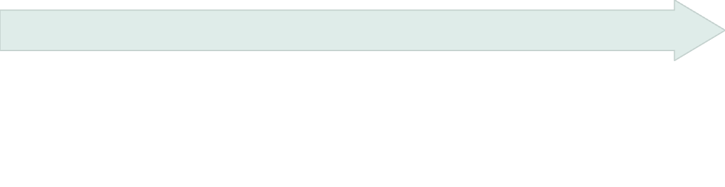
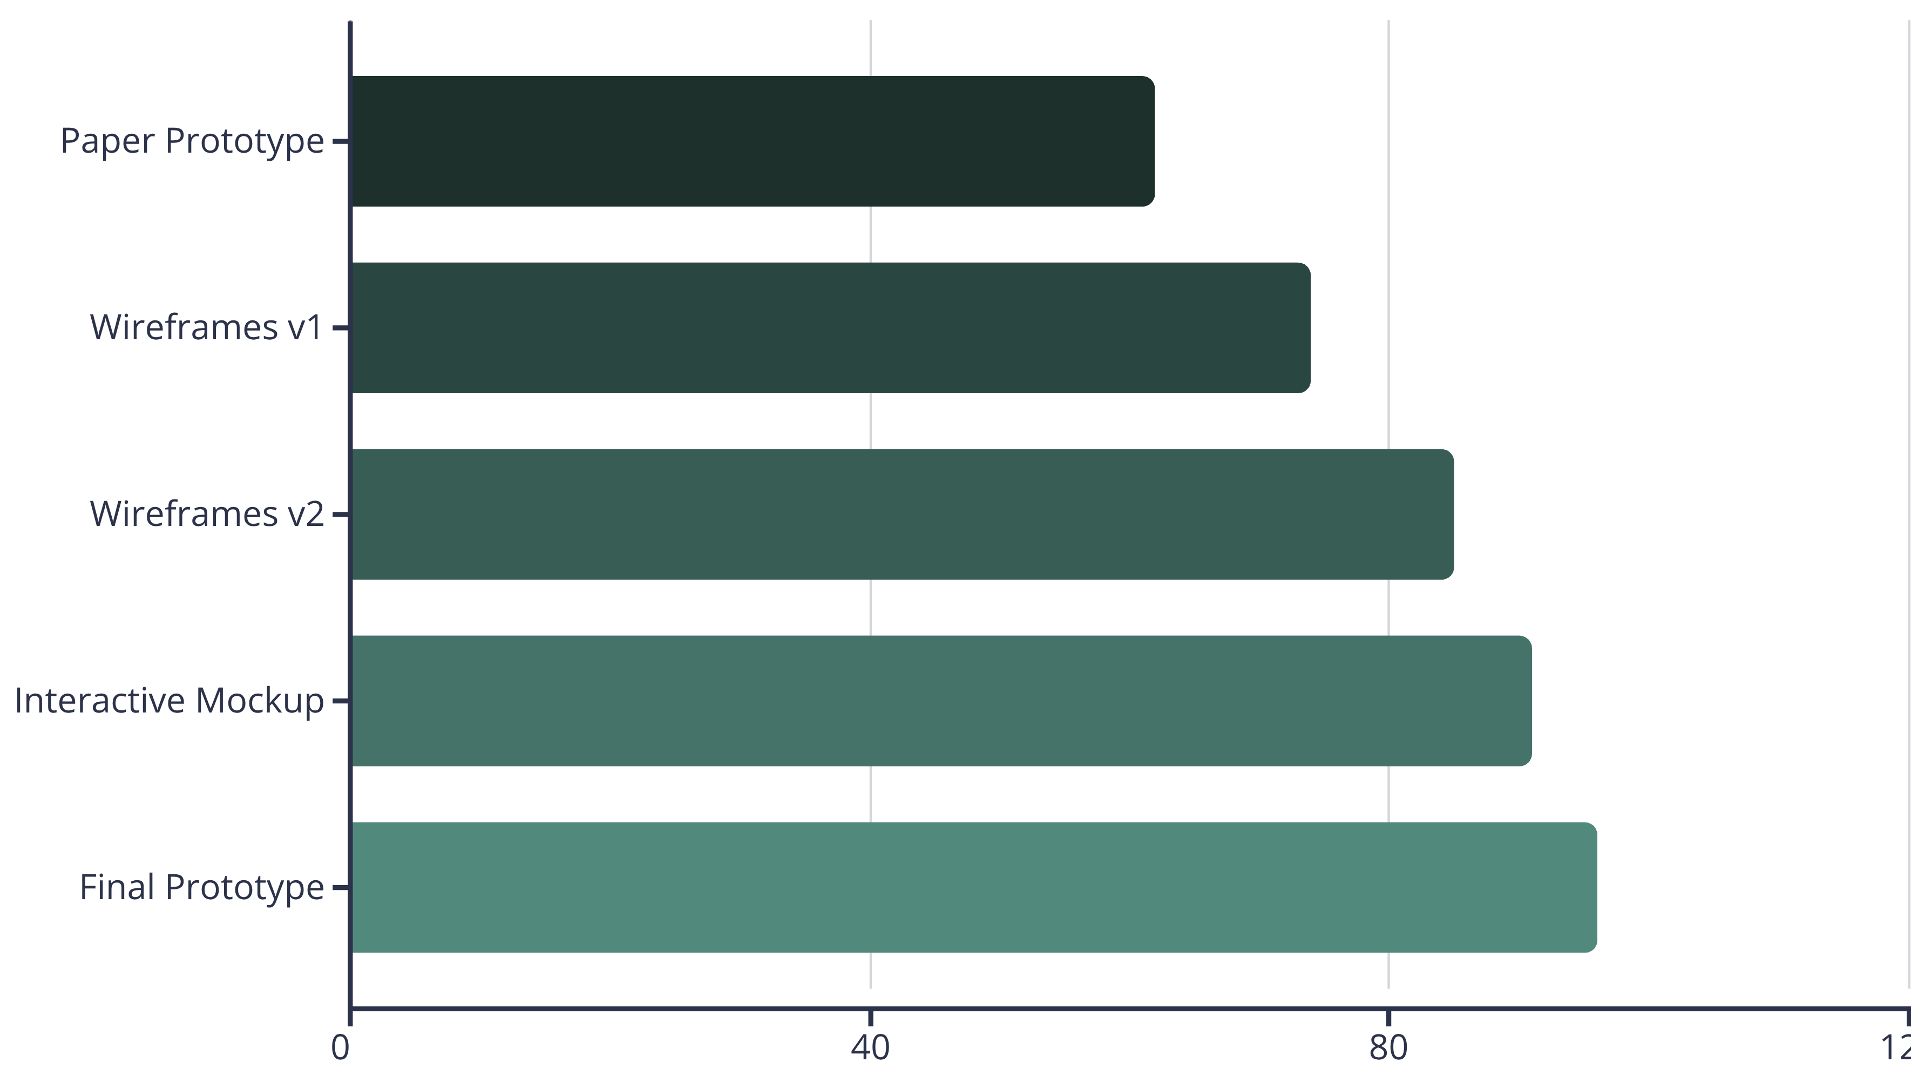
Prototype Phase: Building and Testing Initial Concepts
The Prototype phase transformed abstract ideas into tangible artifacts that users could interact with and provide feedback on. We adopted a progressive fidelity approach, starting with low-fidelity sketches and advancing to high-fidelity interactive prototypes based on validation.
Interactive Mockups
Wireframes
Built clickable prototypes with realistic content and visual design, enabling users to experience near-final interactions and provide detailed feedback on specific features.
Paper Prototypes
Developed digital wireframes showing layout, hierarchy, and interaction patterns. These medium-fidelity prototypes validated core functionality and flow logic.
Created hand-drawn screens and workflows to test basic navigation and information architecture with minimal investment. Rapid iteration cycles identified major usability issues early.
Prototype Testing Results
Each iteration showed measurable improvements in task completion rates and user confidence. By the final prototype, users completed core workflows with 96% success rate and expressed strong satisfaction with the interface clarity and feature accessibility.
Rapid Iteration
User Participation
Technical Feasibility
Completed 12 prototype cycles in 4 weeks, incorporating user feedback within 48 hours to maintain momentum and test improvements quickly.
Engaged 35 representative users across all prototype phases, ensuring diverse perspectives influenced design decisions and feature prioritization.
Collaborated with engineering throughout prototyping to validate technical constraints and ensure proposed solutions aligned with platform capabilities.

Slide 7
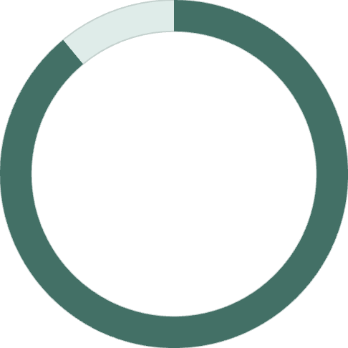

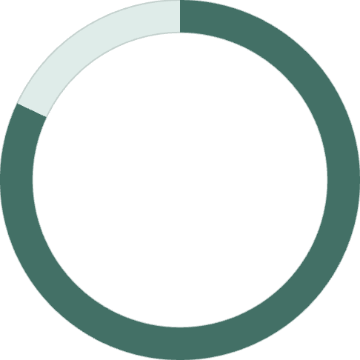
Test Phase: User Feedback and Iteration Cycles
The Test phase subjected our prototypes to rigorous user evaluation, collecting both qualitative feedback and quantitative performance data. This evidence-based approach validated design decisions while revealing opportunities for refinement before full development.
Week 1-2
Week 5
Conducted moderated usability sessions with 15 users, observing task completion and documenting pain points, confusion, and delight moments.
Implemented priority improvements based on testing insights, focusing on areas with lowest success rates and highest user frustration.
1
2
3
4
Week 3-4
Week 6
Ran unmoderated remote tests with 40 participants, gathering data on navigation patterns, time on task, and error rates across diverse environments.
Conducted validation testing with refined prototype, confirming improvements resolved identified issues and achieved target success metrics.
Testing Methodology
Qualitative Methods
Quantitative Metrics
Think-aloud protocols during task completion
Task completion rates and success paths
Post-session interviews exploring experiences
Time-on-task for critical workflows
Emotion mapping throughout user journeys
Error frequency and recovery patterns
Preference testing between design alternatives
System Usability Scale (SUS) scores
89%
96%
82
Task Success Rate
Task Success Rate
SUS Score
Initial prototype testing
After refinement
Exceeding industry average
"The testing phase transformed our good solution into a great one. User feedback revealed blind spots we never would have discovered internally, leading to critical improvements that elevated the entire experience."
Critical Refinements Made
Based on testing insights, we simplified the onboarding flow from 7 steps to 3, reorganized the navigation to surface the most-used features, and added contextual help that reduced support needs by 45%. We also enhanced mobile responsiveness after discovering 40% of users accessed the platform from tablets and smartphones more frequently than anticipated.

Slide 8




Implementation Strategy: Rollout Plan and Resource Requirements
With validated designs in hand, we developed a comprehensive implementation strategy balancing speed to market with risk mitigation. Our phased rollout approach enabled iterative learning while building organizational confidence and user adoption.
Development
Beta Launch
Staged Rollout
6 weeks of agile sprints building core features with continuous quality assurance and integration testing.
2-week pilot with 50 early adopters providing real-world feedback and identifying edge cases.
4-week gradual expansion to full user base with monitoring and rapid response to issues.
Resource Allocation
Resource Category
Team Size
Duration
Product Design
3 designers
12 weeks
Engineering
5 developers
8 weeks
Quality Assurance
2 testers
6 weeks
Project Management
1 PM
12 weeks
Change Management
2 specialists
10 weeks
Documentation & Training
2 writers
4 weeks
Technical Infrastructure
Training Program
Support Readiness
Upgraded cloud hosting capacity by 150% to handle projected user load. Implemented robust monitoring and alerting systems to ensure 99.9% uptime during critical business hours.
Developed comprehensive training materials including video tutorials, interactive guides, and live workshops. Created role-specific learning paths for different user personas and skill levels.
Trained support team on new features and common issues. Established escalation protocols and created knowledge base with 150+ articles covering anticipated user questions.
Risk Mitigation Strategy
We maintained parallel access to legacy systems for 30 days post-launch, ensuring business continuity if critical issues emerged. Feature flags enabled quick rollback of problematic functionality without requiring full deployment reversals.

Slide 9
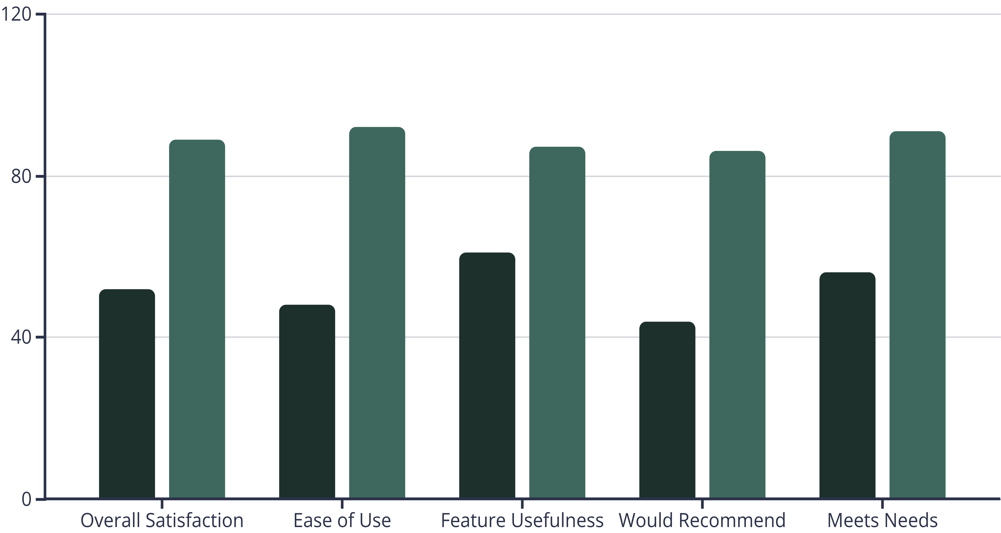
Results and Impact Assessment: Metrics and Outcomes
Three months post-implementation, our solution exceeded target metrics across all key performance indicators. The combination of user-centered design and iterative refinement delivered measurable business value while significantly improving user satisfaction and productivity.
64%
91%
$2.4M
47%
Time Savings
Adoption Rate
Annual Savings
Error Reduction
Average task completion
Within 8 weeks
Productivity gains
Data accuracy improved
User Satisfaction Improvements
Before
After
Operational Impact
Business Outcomes
Support ticket volume decreased 53%
ROI achieved in 5 months vs. 12-month target
Training time reduced from 3 weeks to 4 days
Customer retention improved 18%
User onboarding accelerated by 70%
Net Promoter Score rose from 32 to 67
System integration errors dropped 82%
Competitive differentiation strengthened market position
Mobile usage increased 145% beyond projections
Foundation established for future innovation
"This solution transformed how we work. What used to take hours now takes minutes, and I actually enjoy using the system instead of dreading it."
— Beta User Testimonial

Slide 10
Lessons Learned and Next Steps: Future Recommendations
Our Design Thinking journey yielded valuable insights that will inform future projects. The process validated the power of user-centered design while highlighting areas for continued improvement and expansion of our solution capabilities.
Early User Involvement
Iterative Testing
Engaging users from day one prevented costly late-stage redesigns. Every dollar invested in upfront research saved five dollars in development rework and support costs.
Frequent validation cycles with real users exposed assumptions and blind spots. Small, rapid iterations proved more effective than infrequent large releases.
Cross-Functional Collaboration
Metrics-Driven Decisions
Including engineering, business, and design perspectives throughout created better solutions and smoother implementation with fewer surprises.
Combining qualitative insights with quantitative data created conviction and alignment. Measuring outcomes validated impact and guided prioritization.
Future Roadmap Priorities
Additional Integrations
Enhanced AI Automation
Connect with 12 additional third-party tools identified during user research as commonly used in target workflows.
Expand predictive capabilities and intelligent automation based on user behavior patterns and preferences to further reduce manual effort.
Global Expansion
Advanced Analytics
Localize interface and support for 8 additional languages and cultural contexts to serve international markets.
Develop customizable dashboards and reporting features that provide actionable insights into productivity trends and bottlenecks.
Key Recommendations
For Future Projects
Continuing This Project
Allocate 25-30% of project timeline to user research and testing
Maintain regular user feedback channels through quarterly surveys, monthly user group sessions, and continuous support ticket analysis. Establish a quarterly review cycle to assess metrics, prioritize enhancements, and ensure the solution evolves with changing user needs and market conditions.
Create cross-functional core teams from project inception
Build prototyping and iteration time into schedules
Establish clear success metrics before design begins
Plan for post-launch optimization and enhancement
Final Reflection
The Design Thinking process proved invaluable in creating a solution that truly serves user needs while delivering strong business outcomes. The methodology's emphasis on empathy, experimentation, and iteration transformed an ambitious concept into a successful, adopted product that continues to evolve and improve.

